Slide 1


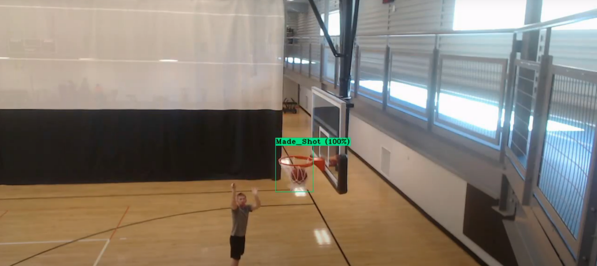
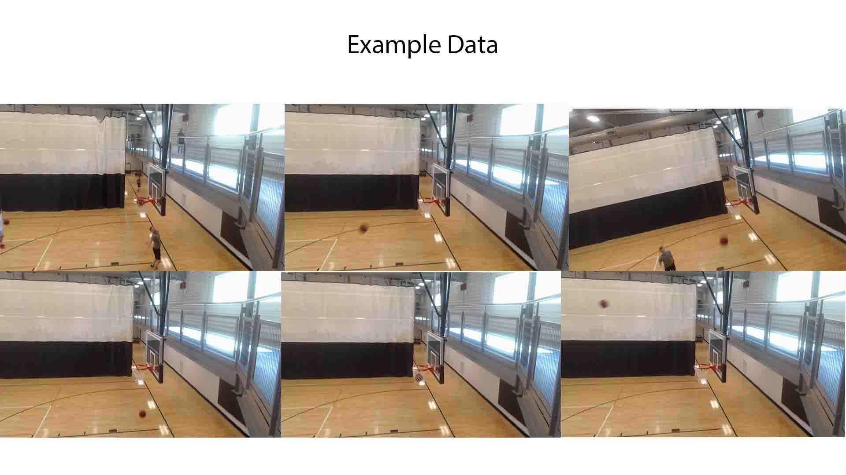
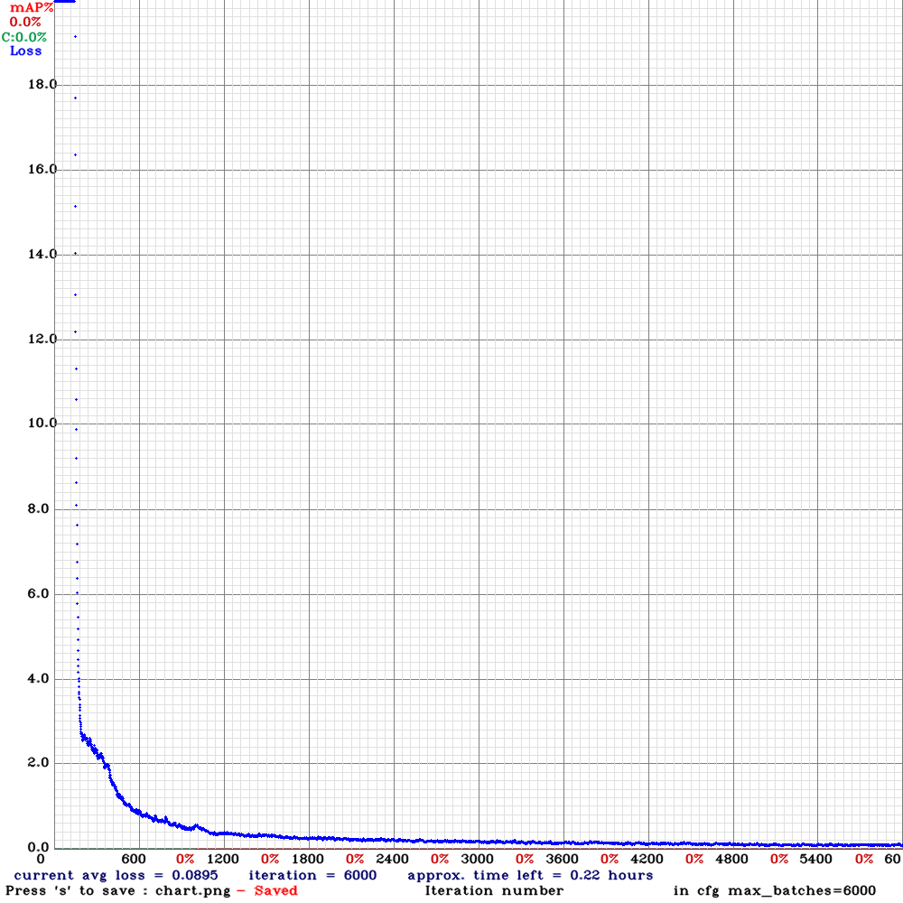
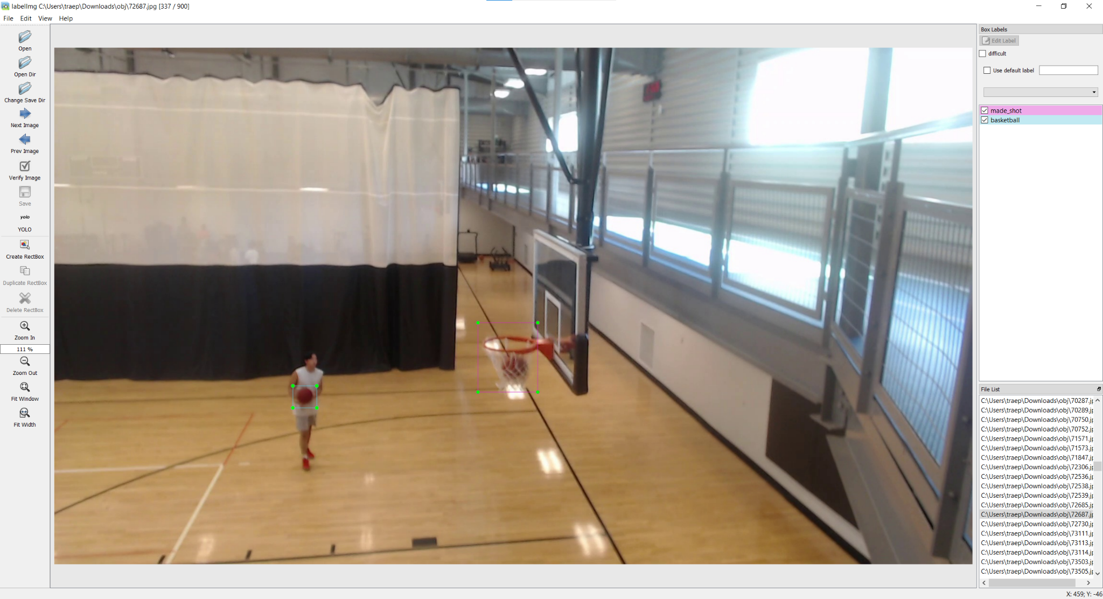
Trae Primm
Basketball Tracking with Computer Vision,
Senior Capstone Project, Fall 2021
Faculty Advisor: Dr. Rad Alrifai
Northeastern State University
Abstract
Training
Results
Applying new and exciting technologies to everyday life is an exciting process and without it what would be the purpose of it. When thinking of how new technology could change things I thought of some of my personal hobbies and interests first. That being basketball and with computer vision my goal is to track elements of a basketball game. To start a giant task like this a good starting point would be to capture the basic element of basketball, that being made shots. At this level of implementation it could be used by further research to improve the system and casual users to be able to see how many shots they made. To further build upon this project and idea this element would be a core aspect of tracking all stats of a basketball game.
When building the Yolov4 it has the same setup as Yolov3, when using darknets package. The things that have to be altered is the indicated cfg file, and create a .data file for the dataset that was created. Due to me having a windows computer I could not build the model on my local machine so I used google colab. To train the model in google colab I had to run this command:
!./darknet detector train data/obj.data cfg/yolov4-basketball.cfg yolov4.conv.137 -dont_show -map
This states left to right the .data file, cfg, and the training weights needed. During the training process I started it and monitored it for a bit before I went to bed and let it run over night. I was able to generate a graph (FIgure 1) of how the lose function changes over the number of batches.
Figure 1
By looking at this graph it shows that it starts off very inaccurate but then moves to be fairly accurate and in the testing phase it only reported a handful of false positives.
I recorded a separate video 3min video for testing purposes. To create a demo I used the demo function and just stated where the mp4 was located in my drive. The demo function does not output any data to use it just creates a demo. To perform the test function it can not use mp4 and only images so I reused my python script that turns the training video into images for the test video. Bellow is an example screenshot from the demo.
Data Collection
Above are example images used to train the YOLO model for my purposes. When using the yolo model it needs a txt file as well to declare the coordinates and the class of the objects in the image. Thankfully Tzutalin has created a tool to use to create these txt files that are needed. This software is labelimg and it is used for different models and one of them is YOLO format.
Conclusion
When looking at the result I would say that I have a concrete standings to expand on this project and develop it more to add the other stats to track. Now I would not say this is even the best model to run things off of considering all of my data is of the same goal in the same position realistically means that it will only work for this same meaning and if I set up the camera for a different goal the model my not work due to overfitting. To fix this I would just need more diverse data to train on.
Data Processing
Future Proceedings
I used the process_results.py script to process the output file that was generated by the test function. This python script used the pandas library for ease of use. The process looks for keywords in each line of the result file and appends that to a list. After the initial csv is generated then it performs some of the parameters set for the demo to get similar results such as dropping values with a confidence score below 80%. Currently the data shows every frame including multiple frames for the same shot. The next code chunk reduces it down to one frame per shot to keep counting simple.
I think the next step in a complete system would be to fully hash out a stem instead of getting knee deep in multiple different systems. I think I should advanced the concepts of shooting further to start with I would want the system to be able to differentiate the different types of goals, those being threes, twos, and ones. For this I would need to change the camera angle to more of a top down view, this would help with distance differentiating. I would also need to be able to set up a system to recognize when the jumpshot happens, shouldn’t be to difficult considering majority of players shoot with the ball over their head. I think creating a more complex model is achievable in time and I can’t wait to work on this more.
References
Tzutalin. LabelImg. Git code (2015). https://github.com/tzutalin/labelImg
Bochkovskiy, A., Wang, C. Y., & Liao, H. Y. M. (2020). Yolov4: Optimal speed and accuracy of object detection. arXiv preprint arXiv:2004.10934.

